Slide 1
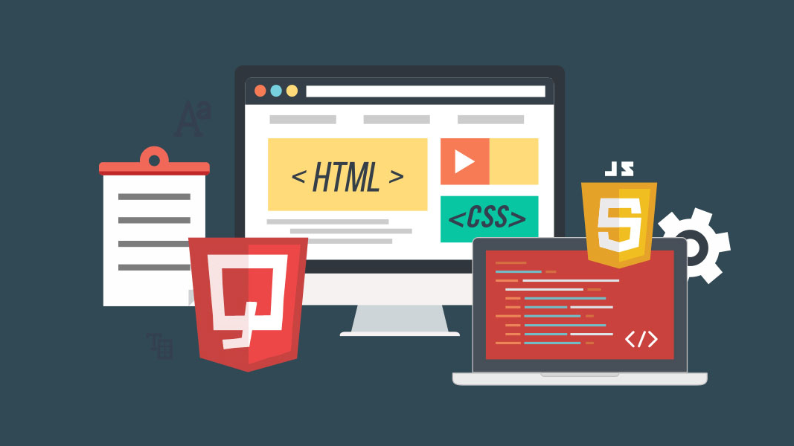
Auto
Blogger
By-
Priyanshu Singh
Prabhakar Singh Nayal
Ritik Kumar Gupta

Slide 2

Why text content is important
Blog
A blog is a discussion or informational website published on the World Wide Web consisting of discrete, often informal diary-style text entries .
Importance of Blogging
Keep Your Audience Engaged and Share Relevant, Helpful Content
Promote the Idea of a Community Centered Around Your Organization
Advertise While Sharing Meaningful Content
Build Trust with Your Audience

Slide 3

Problem Statement
01
Time Consuming
Handling multiple types of Content Creation becomes cumbersome.
02
Low Productivity
Slow Content Creation can result into Low Productivity.
03
Bad Writing Skill
New Blog Writers or Video Content Creators lack in writing skills which lead to inefficient results.

Slide 4
Problem Statement
04
Quality Post
If not written properly even great content can fail in achieving the desired objective.
05
Inconsistency
Higher workload for creating large amount of content will cause inconsistency in delivering the content to your audience.
06
Hire an employee
New and Small Businesses cannot afford hiring more team members because of limitation in resources

Slide 5

Introduction
We are creating a platform for Converting any Video Content to very engaging and well designed blogs in order to solve the previous problems.

Slide 6

Objective
It will automate the process of blogging.
Auto Blogger system which can help you to save time and your hardwork.
Gain Exposure and Visibility.
Bring More Value to the User.

Slide 7

Purpose and Scope
It can be used by technical and non- technical user
It will help Other Content Creator to get into Blogging without effort.
It will help user’s content to get more reach.

Slide 8






Proposed System
Image
Automatic Blog Creation System
Image Extraction Selection System
Video
Video Transcribing System
Blog
Text

Slide 9

Feasibility Study
A feasibility analysis is used to determine the viability of an idea. It tells us whether a project is worth the investment- in some cases, a project may not be doable
Types of Feasibility Study
Technical Feasibility: This assessment focuses on the technical resources available to the organization.
Economic Feasibility: This assessment typically involves a cost/benefits analysis of the project
Operational Feasibility: This assessment involves undertaking a study to analyze and determine whether - and how well-the organization's needs can be met by completing the project.

Slide 10
Gantt Chart
Task | 25Jan-23Feb | 24Feb-5Mar | 6Mar-8Apr | 9Apr-12May | 13may-18may | 19may-25may
Develop project proposal | 30 days
Analysis |  | 10 days
Designing |  |  | 34 days
Coding |  |  |  | 34days
Unit Testing |  |  |  |  | 7 days
Implementation |  |  |  |  |  | 6 days

Slide 11
Hardware Requirements
Client Side
Processor - Dual Core or above
RAM - 1 GB
Disk space - 120 GB
Monitor - 14” or above/ tab/ mobile
Others - Internet Connection
Developer Side
Processor - Quad Core or above (1.5 GHz or more)
RAM - 4 GB or above
Disk space - 256 GB
Monitor - 14” or above
Others - Internet Connection

Slide 12

Module Description
01 Video Transcribing System
02 User Authentication
A User authentication is a service that collects user information such as a user ID and password.
The Video transcribing system is a system which converts the speech in a video to text..
04 Automatic Blog Creation System
03 Image Extraction Selection System
Auto blogging is a process using which you can automatically create new
Image extraction and Selection System is a technique which are applied to get features that will be useful in classifying and recognition of images
05 Video Management
A video management system Collects video from devices and other sources and Records / stores that video to a storage device.

Slide 13

Module Description
06 Blog Management System
07 Blog Rating & Reviews System
Blog Management System is a system that allows you to create, organize, publish, and delete content on a website.
It is a system where readers can give your blog rating and review.
08 Blog publishing system
09 Blog Subscription System
A blog publishing system is a software or service used to manage and publish content on the internet in the form of a blog.
When you subscribe to a blog, you get all of its new features and updates delivered to you
10 YouTube Downloader
11 Scheduling System
Youtube downloader allows user to save youtube videos to their device.
It is a system which is used to schedule the time of your blog for publishing.

Slide 14
Module Description
12 Feedback System
A feedback system is the one which utilizes presently achieved output of the system for causing variation in the applied input signal in order to get the required output.
13 Blog Browsing System
Feedback System
Blog browsing system is a system which allows user to browse or search any of his blog which he/she posted .
Blog Browsing System
Payment Gateway
User/Admin Dashboard
14 Payment Gateway
15 User/Admin Dashboard
The payment gateway is a system to support the transaction between you and your clients.
The Administrative Dashboard provides administrators direct access to important Encompass tools.

Slide 15
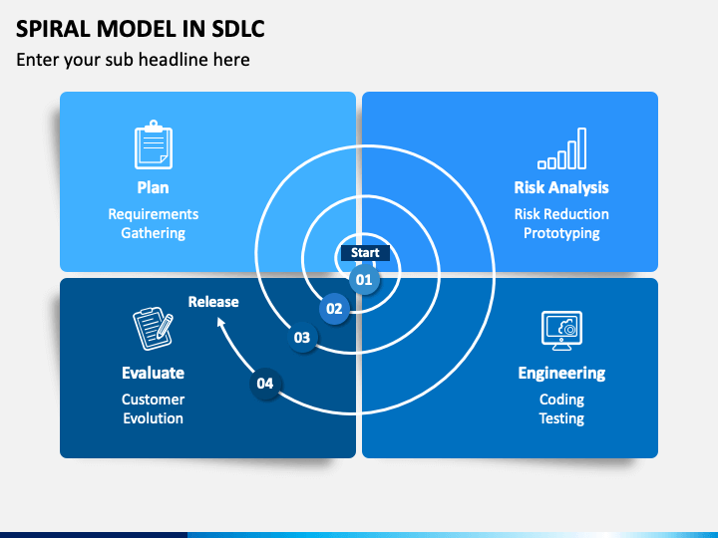
Life Cycle Model
Spiral Model

Slide 16
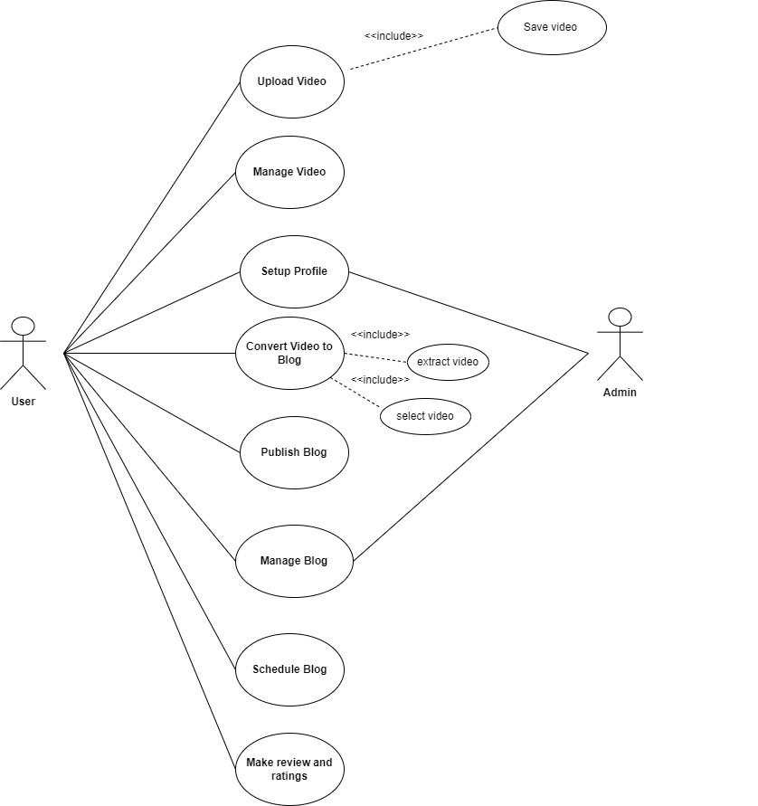
Use case diagram

Slide 17
Use case diagram
Use case diagram

Slide 18
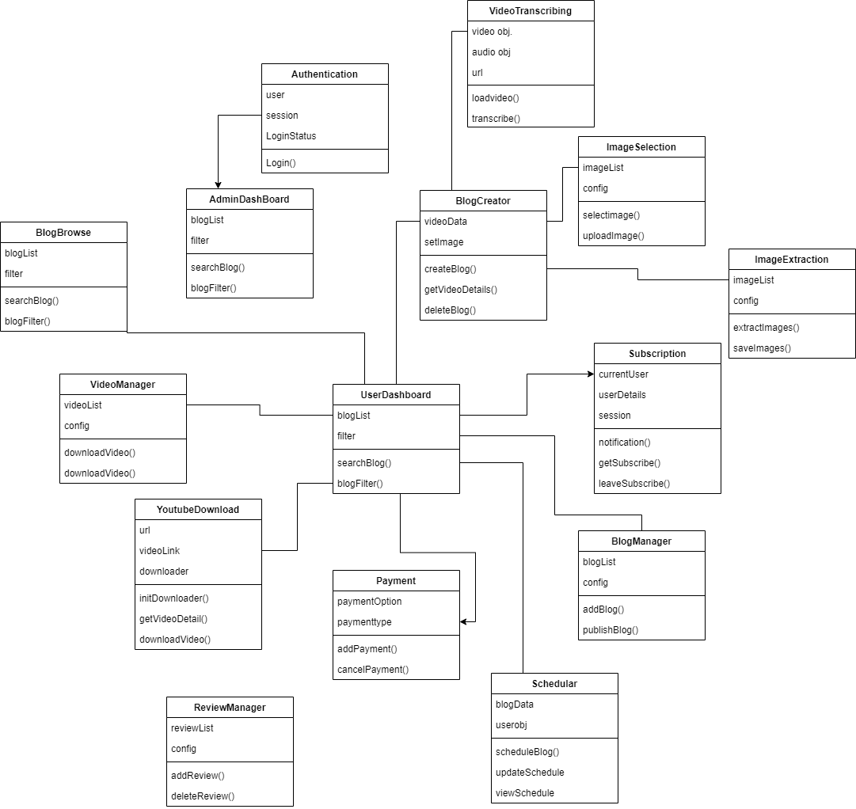
Class Diagram

Slide 19
Class Diagram

Slide 20

Conclusion
This Project will result in increased productivity of the Content Creators as they can automate the process of Blog Creation which takes a lot of time. In Future this project can also be used to create Blog by using the content in any format. These types of automated systems are useful in bringing the Content Creation to the next level.

Slide 21


